Slide 1
Sustainable Development Goals (SDGs) and Civil Society
Training Workshop
Yangon, Myanmar / 26 July 2017
Anselmo Lee
alee7080@gmail.com
Co-convener, Asia Development Alliance (ADA)
Secretary General, Asia Democracy Network (ADN)

Slide 2
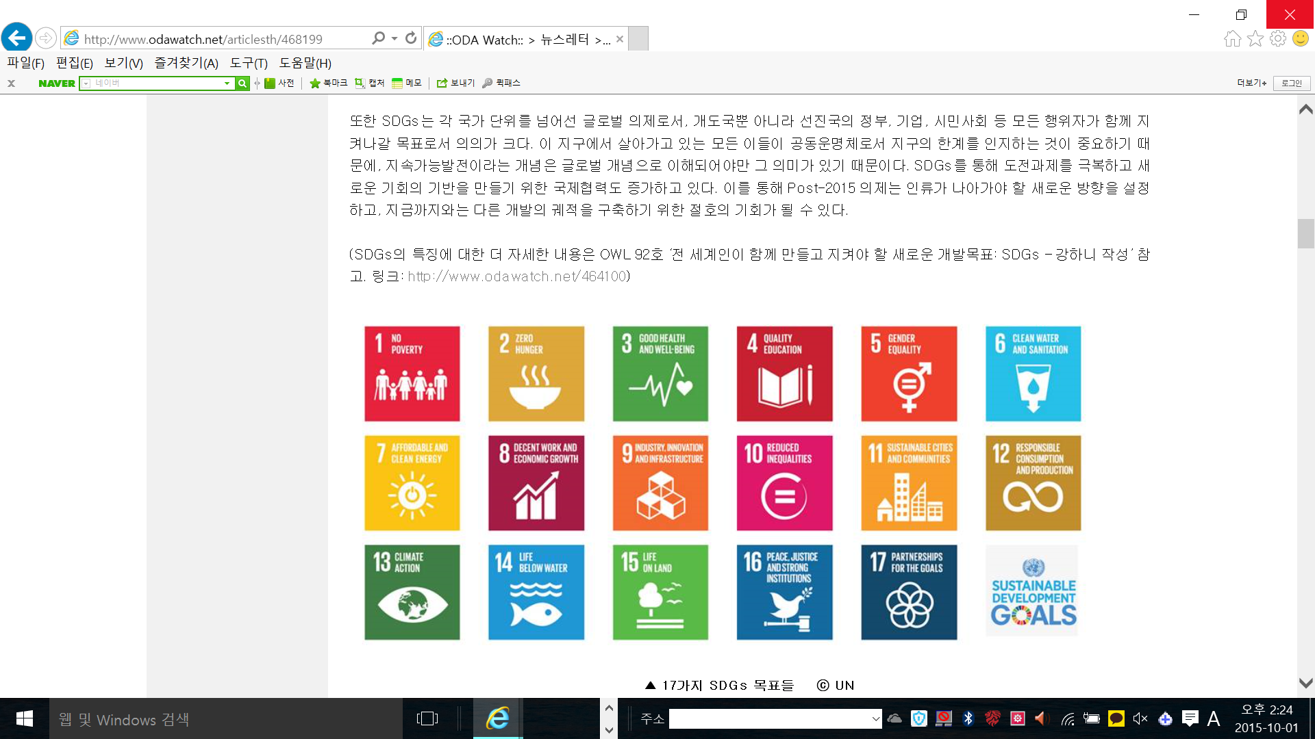

Sustainable Development Goals (SDGs)

Slide 3
ADA
Asia Development Alliance
AND
Asia Democracy Network
www.ada2030.org
Founded in Bangkok in Feb. 2013 as a regional network of national/sub-national CSOs/NGOs platforms in Asia
ada2030.secretariat@gmail.com
www.ADN21.asia
Founded in Seoul in Oct. 2013 as a regional network of regional CSOs/NGOs engaged in democracy-related issues in Asia.
asiademocracynetwork@gmail.com

Slide 4
Contents
1. SDGs – What and Why
  History, structure, contents,
2. SDG Implementation and monitoring mechanisms
  Key actors, architecture and governance
  (sub)national, regional and global level
  Key Events on SDGs 2015-2030 and 2017
3. SDGs and Civil Society / NGOs
4. SDGs and Human Rights

Slide 5
Useful websites
https://sustainabledevelopment.un.org/
https://sustainabledevelopment.un.org/hlpf
http://www.unescap.org/events/apfsd4
http://www.sdg16.org/
http://action4sd.org/
http://tapnetwork2030.org/
http://asiapacificrcem.org/
www.ADN21.asia
www.ADA2030.org

Slide 6
Bringing the ‪SDGs‬ to life: real change for real people by IIED https://www.youtube.com/watch?v=hhKIIQIyI6s&t=78s
Country | Name | Issues / SDG
1.
2.
3.
4.
5.

Slide 7
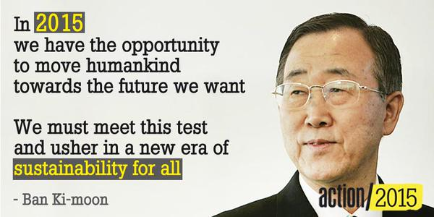

Slide 8
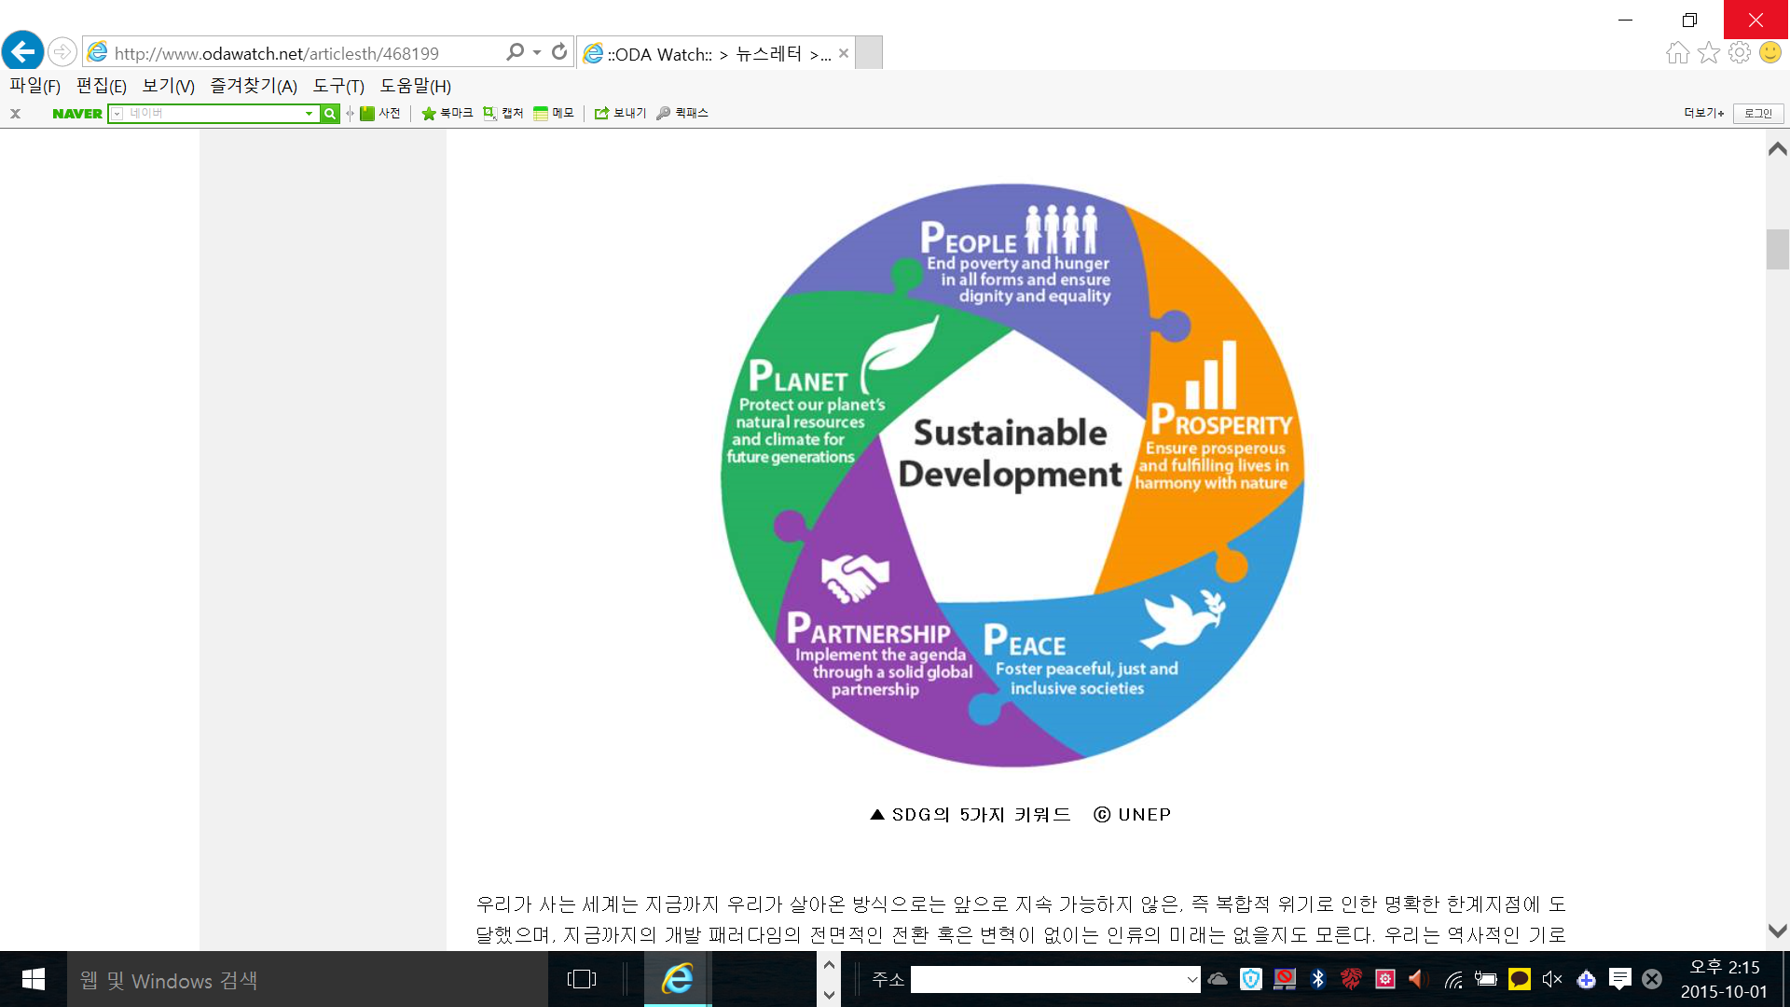


Slide 9
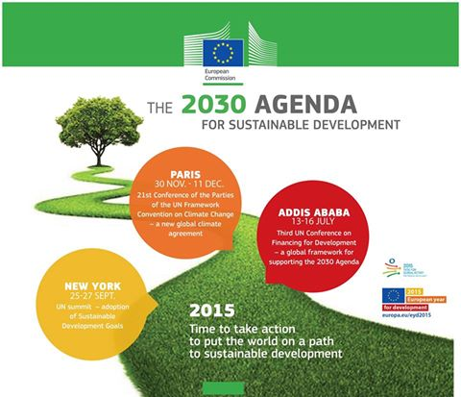

Slide 10
Post-2015 Roadmap
FfD Process
9.25~27
UN
Post-2015
Summit
NYC
1.27~29
Drafting session 1
4.13~17
Drafting session 2
6.15~19
Drafting session3
7.13~16
FfD3
Addis Ababa
11.30~12.11
COP21
Paris
Post-2015 Process
1.19-21
Stocktaking
2.17~20
Declaration
3.23~27 SDGs
4.21~24
MOI
5.18~22
Follow-up
6.22~25
Finalization
7.20~24 / 7.27~31
Finalization

Slide 11
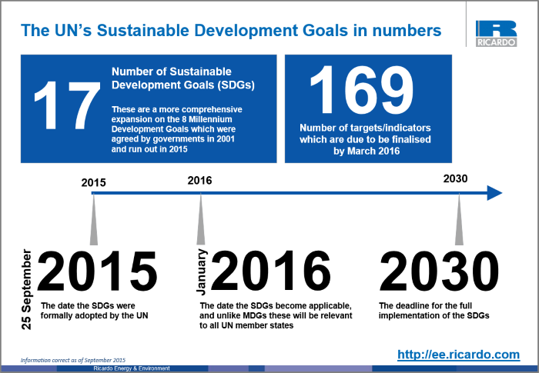

Slide 12
2017 for SDGs
The 2nd year of the SDG implementation since its adoption in 25 Sept. 2015.
From standard-setting (2015) to implementation stage (2016-2030)
Planning stage at the national and sub-national level (2016-2017)
  Institution-building
  National action planning
  Monitoring mechanism

Slide 13
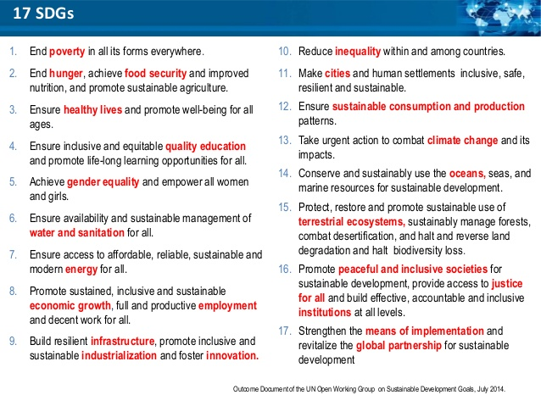

Slide 14
SDG Story-telling
My name is 000. I am a 000 from 000 …
SDG 1-5
I am very poor (1) so hungry (2, no food), sick (3, no medicine) and uneducated (4, no education or wrong education) so I do not know about gender equality (5).
SDG 6-10
I drink water (6) to get energy (7) to work (8) hard for industrialization and innovation (9) to reduce inequality (10).
SDG 11-15
I live in a city (11) but produce and consume too much (12) and it creates climate change (13), and negatively impacting on oceans (14) and lands (15).
SDG 16-17
In order to solve all those problems, we need peace, human rights and democracy (PHD) (16) and effective means of implementation (MoI) and global partnership. (17).

Slide 15
Transforming our World: the 2030 Agenda for
Sustainable Development (A/70/L.1) (9.25.2015)
Preamble
Declaration (1-53)
  Introduction (1-6)
  Our Vision (7-9)
  Our shared principles and commitments (10-13)
  Our world today (14-17)
  The new agenda (18-38)
  Means of implementation (39-46)
  Follow-up and review (47-48)
  A call for action to change our world (49-53)
Sustainable Development Goals and targets (54-59)
Means of implementation and the Global Partnership (60-71)
  Finance (17.1-17.5)
  Technology (17.6)
  Capacity-building (17.9)
  Trade (17.10-12)
  Systemic Issues
    Policy and Institutional Coherence (17.13-15)
    Multi-stake holder partnerships (17.16-17)
    Data, monitoring and accountability (17.18-19)
Follow-up and review (72-91)
  National level (78-79)
  Regional level (80-81)
  Global level (82-90)

Slide 16
Transforming our World: the 2030 Agenda for
Sustainable Development (A/70/L.1) (9.25.2015)
Section | Contents |  |  | No of Paragraph
Preamble | People, Prosperity, Planet, Peace and Partnership
Declaration (1-53) | Introduction |  |  | 1-6
 | Our Vision |  |  | 7-9
 | Our shared principles and commitments |  |  | 10-13
 | Our world today |  |  | 14-17
 | The new agenda |  |  | 18-38
 | Means of implementation |  |  | 39-46
 | Follow-up and review |  |  | 47-48
 | A call for action to change our world |  |  | 49-53
Sustainable Development Goals and targets (54-59) |  |  |  | 54-58
 | SDG 1-17 and Targets |  |  | 59
 | Finance |  |  | 17.1-17.5
 | Technology |  |  | 17.6
 | Capacity-building |  |  | 17.9
 | Trade |  |  | 17.10-17.12
 | Systemic Issues |  | Policy and Institutional Coherence | 17.13-17.15
 |  |  | Multi-stake holder partnerships | 17.16-17.17
 |  |  | Data, monitoring and accountability | 17.18-17.19
Means of implementation and the Global Partnership |  |  |  | 60-71
Follow-up and review (72-91) |  |  |  | 72-77
 |  | National level |  | 78-79
 |  | Regional level |  | 80-81
 |  | Global level |  | 82-91

Slide 17
SDGs Targets a,b,c,d are MoI-related targets )행관련 세부목표)
Goal | No of Targets | 1 | 2 | 3 | 4 | 5 | 6 | 7 | 8 | 9 | 10 | 11 | 12 | 13 | 14 | 15 | 16 | 17 | 18 | 19
1 | 7 (5+2) | 1 | 2 | 3 | 4 | 5 | a | b
2 | 8 (5+3) | 1 | 2 | 3 | 4 | 5 | a | b | c
3, | 13 (9+4) | 1 | 2 | 3 | 4 | 5 | 6 | 7 | 8 | 9 | a | b | c | d
4 | 10 (7+3) | 1 | 2 | 3 | 4 | 5 | 6 | 7 | a | b | c
5 | 9 (6+3) | 1 | 2 | 3 | 4 | 5 | 6 | a | b | c
6 | 8 (6+2) | 1 | 2 | 3 | 4 | 5 | 6 | a | b
7 | 5 (3+2) | 1 | 2 | 3 | a | b
8 | 12 (10+2) | 1 | 2 | 3 | 4 | 5 | 6 | 7 | 8 | 9 | 10 | a | b
9 | 8 (5+3) | 1 | 2 | 3 | 4 | 5 | a | b | c
10 | 10 (7+3) | 1 | 2 | 3 | 4 | 5 | 6 | 7 | a | b | c
11 | 10 (7+3) | 1 | 2 | 3 | 4 | 5 | 6 | 7 | a | b | c
12 | 11 (8+3) | 1 | 2 | 3 | 4 | 5 | 6 | 7 | 8 | a | b | c
13 | 5 (3+2) | 1 | 2 | 3 | a | b
14 | 10 (7+3) | 1 | 2 | 3 | 4 | 5 | 6 | 7 | a | b | c
15 | 12 (9+3) | 1 | 2 | 3 | 4 | 5 | 6 | 7 | 8 | 9 | a | b | c
16 | 12 (10+2) | 1 | 2 | 3 | 4 | 5 | 6 | 7 | 8 | 9 | 10 | a | b
17 | 19 | 1 | 2 | 3 | 4 | 5 | 6 | 7 | 8 | 9 | 10 | 11 | 12 | 13 | 14 | 15 | 16 | 17 | 18 | 19
Total | 169 (112+57)

Slide 19

Which one?

Slide 20
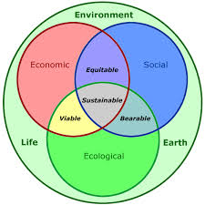
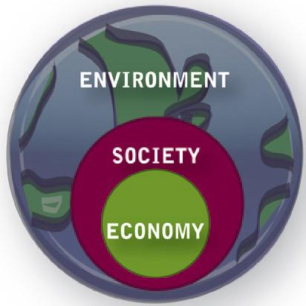
Sustainable Development Framework

Slide 22
SDGs Structure – 5Ps
 | Social Development | Economic development |  | Environment
5 P | People) | Prosperity |  | Planet
What | 1,2, 3, 4, 5 + | 7, 8, 9, 10, 11 + |  | 12, 13, 14, 15, +
What+ How | Peace, Human Rights and Democracy (PHD) Justice and Peace, Democratic Governance, etc. (16) |  | Peace
How | Means of Implementation (MoI) and Global Partnerships (17) |  | Partnership

Slide 23
Goal 16. Promote peaceful and inclusive societies for sustainable development, provide access to justice for all and build effective, accountable and inclusive institutions at all levels
Targets
16.1 Significantly reduce all forms of violence and related death rates everywhere
16.2 End abuse, exploitation, trafficking and all forms of violence against and torture of children
16.3 Promote the rule of law at the national and international levels and ensure equal access to justice for all
16.4 By 2030, significantly reduce illicit financial and arms flows, strengthen the recovery and return of stolen assets and combat all forms of organized crime
16.5 Substantially reduce corruption and bribery in all their forms
16.6 Develop effective, accountable and transparent institutions at all levels
16.7 Ensure responsive, inclusive, participatory and representative decision-making at all levels
16.8 Broaden and strengthen the participation of developing countries in the institutions of global governance
16.9 By 2030, provide legal identity for all, including birth registration
16.10 Ensure public access to information and protect fundamental freedoms, in accordance with national legislation and international agreements
16.a Strengthen relevant national institutions, including through international cooperation, for building capacity at all levels, in particular in developing countries, to prevent violence and combat terrorism and crime
16.b Promote and enforce non-discriminatory laws and policies for sustainable development.

Slide 24
SDG 17 – MoI and Partnerships
Systemic Issues
Finance
Technology
Capacity-building
Trade
Policy and Institutional Coherence
Multi-stake holder partnerships
Systemic
issues
Data, Monitoring and Accountability

Slide 25
Finance
17.1 Strengthen domestic resource mobilization, including through international support to developing countries, to improve domestic capacity for tax and other revenue collection
17.2 Developed countries to implement fully their official development assistance commitments, including the commitment by many developed countries to achieve the target of 0.7 per cent of gross national income for official development assistance (ODA/GNI) to developing countries and 0.15 to 0.20 per cent of ODA/GNI to least developed countries; ODA providers are encouraged to consider setting a target to provide at least 0.20 per cent of ODA/GNI to least developed countries
17.3 Mobilize additional financial resources for developing countries from multiple sources
17.4 Assist developing countries in attaining long-term debt sustainability through coordinated policies aimed at fostering debt financing, debt relief and debt restructuring, as appropriate, and address the external debt of highly indebted poor countries to reduce debt distress
17.5 Adopt and implement investment promotion regimes for least developed countries

Slide 26
Technology
17.6 Enhance North-South, South-South and triangular regional and international cooperation on and access to science, technology and innovation and enhance knowledge sharing on mutually agreed terms, including through improved coordination among existing mechanisms, in particular at the United Nations level, and through a global technology facilitation mechanism
17.7 Promote the development, transfer, dissemination and diffusion of environmentally sound technologies to developing countries on favourable terms, including on concessional and preferential terms, as mutually agreed
17.8 Fully operationalize the technology bank and science, technology and innovation capacity-building mechanism for least developed countries by 2017 and enhance the use of enabling technology, in particular information and communications technology
Capacity-building
17.9 Enhance international support for implementing effective and targeted capacity-building in developing countries to support national plans to implement all the Sustainable Development Goals, including through North-South, South-South and triangular cooperation

Slide 27
Trade
17.10 Promote a universal, rules-based, open, non-discriminatory and equitable multilateral trading system under the World Trade Organization, including through the conclusion of negotiations under its Doha Development Agenda
17.11 Significantly increase the exports of developing countries, in particular with a view to doubling the least developed countries’ share of global exports by 2020
17.12 Realize timely implementation of duty-free and quota-free market access on a lasting basis for all least developed countries, consistent with World Trade Organization decisions, including by ensuring that preferential rules of origin applicable to imports from least developed countries are transparent and simple, and contribute to facilitating market access.

Slide 28
Systemic issues
Policy and institutional coherence
17.13 Enhance global macroeconomic stability, including through policy coordination and policy coherence
17.14 Enhance policy coherence for sustainable development
17.15 Respect each country’s policy space and leadership to establish and implement policies for poverty eradication and sustainable development
Multi-stakeholder partnerships
17.16 Enhance the Global Partnership for Sustainable Development, complemented by multi-stakeholder partnerships that mobilize and share knowledge, expertise, technology and financial resources, to support the achievement of the Sustainable Development Goals in all countries, in particular developing countries
17.17 Encourage and promote effective public, public-private and civil society partnerships, building on the experience and resourcing strategies of partnerships

Slide 29
Data, monitoring and accountability
17.18 By 2020, enhance capacity-building support to developing countries, including for least developed countries and small island developing States, to increase significantly the availability of high-quality, timely and reliable data disaggregated by income, gender, age, race, ethnicity, migratory status, disability, geographic location and other characteristics relevant in national contexts
17.19 By 2030, build on existing initiatives to develop measurements of progress on sustainable development that complement gross domestic product, and support statistical capacity-building in developing countries

Slide 30
SDGs = SD + Goals
Sustainable Development from World Summit on Sustainable Development (WSSD) (Rio+10, 2002))
Goals from Millennium Development Goals (MDGs)
SDGs originally from the outcome document of the UN Conference
on Sustainable Development (UNCSD) (June 2013) (Rio+20)
World Summit on Sustainable Development (WSSD)
Millennium Development Goals ( MDGs)
Sustainable Development Goals (SDGs)

Slide 31
Origin of Sustainable Development
Our Common Future (the Brundtland Report, 1987)
"Sustainable development is development that meets the needs of the present without compromising the ability of future generations to meet their own needs. It contains within it two key concepts:
  the concept of needs, in particular the essential needs of the world's poor, to which overriding priority should be given; and
  the idea of limitations imposed by the state of technology and social organization on the environment's ability to meet present and future needs."

Slide 32
개발Development 발전이란?
Development is a comprehensive economic, social, cultural and political process, which aims at the constant improvement of the well-being of the entire population and of all individuals on the basis of their active, free and meaningful participation in development and in the fair distribution of benefits resulting therefrom, …
UN Declaration on the Right to Development (1986)

Slide 33
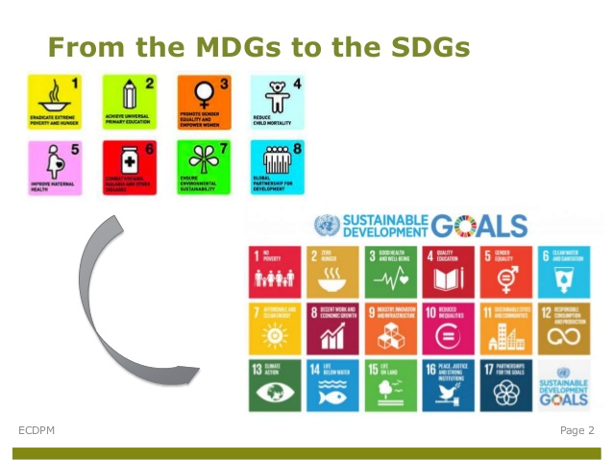

Slide 34
MDGs vs. SDGs
 | MDGs | SDGs
When (period) | 2001-2015 | 2016-2030
Where | Developing countries | Both Developing and developed countries
Who (key actors) | GO, IGO, etc. | GO, IGOs, Private Sector, Local Government, etc.
What | Extreme poverty (social development) 18 Goals, 18/21 Targets, 4/60 Indicators | Sustainable Development (Economic, social and environment and governance) 17 Goals, 169 Targets 241 Indicators
How (MoI) | Finance(ODA), technology, trade, etc. | Finance, Technology, Capacity-building, Trade and systemic issues
Why (context) | Millennium Summit, 9.11 Attacks | Multiple Global Crisis (Food, Fuel, Finance (3Fs) and CC)

Slide 35

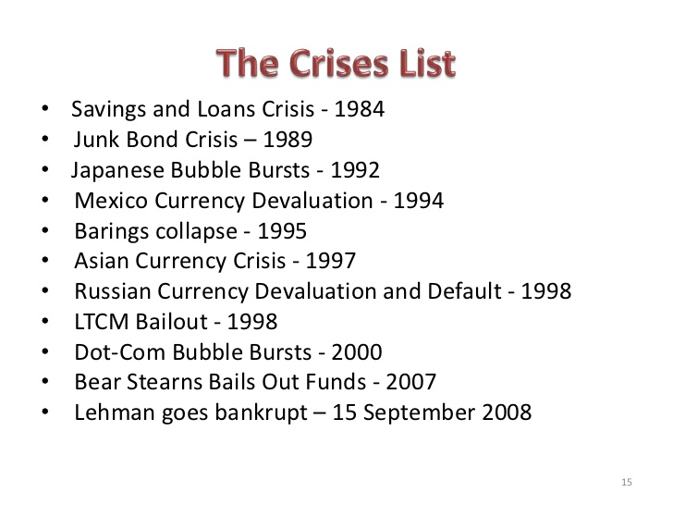
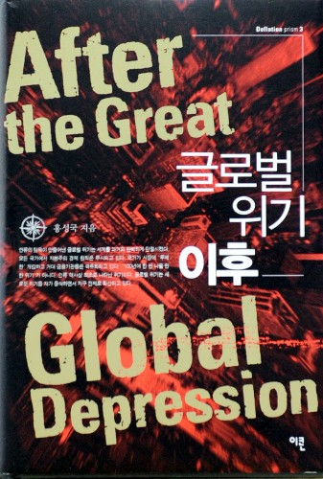

Slide 36




Post-2015 World vs. Future

Slide 37
SDGs – Self-definition
“A plan of action for people, planet and prosperity. (Preamble)
“A charter for people and planet in the 21st century” (para. 51)
“An agenda of the people, by the people and for the people” (para. 52)
Stupid and Dangerous Goals
Singing and Dancing Group
Something D… and G … ???

Slide 38
SDGs 특성 – “I I ACT U U”
Inclusive
– ‘Leave no one behind’
Accountable
Comprehensive / integrated
Transformative
Universal
Accountable
Universal
Inclusive
Comprehensive
Transformative

Slide 39

PHD
SDGs와 평화, 개발 및 인권
"We will not enjoy development without security(peace), we will not enjoy security without development, and we will not enjoy either without respect for human rights.
Unless all these causes are advanced, none will succeed."
Kofi Annan, UNSG(1997-2006)

Slide 40
2030 Agenda Components
Millennium Declaration 2000
MDGs
Rio+20
UNFCCC
AAAA
Millennium Declaration 2000
MDGs (2002)
Rio+20 :
  UNCED (1992),
  WSSD (2002, Rio+10),
  UNCSD (2012, Rio+20)
UNFCCC – Paris Agreement (Dec. 2015)
Addis Ababa Action Agenda (AAAA) for Financing for Development (FfD) (July 2015)
  Monterrey Consensus (2002)

Slide 41
SDG – Global Governance
New York
Washington D.C.
Geneva
Nairobi
Paris
New York
  UN Headquarters
  UNDP
  HLPF
Washington D.C
  World Bank
  IMF
Geneva – UNHRC, OHCHR, ILO, WHO,
Nairobi – UNEP, UN HABITAT, etc.
Paris – OECD, UNESCO
Notes:
P

Slide 42
Key International Mechanisms on SDGs
 | UN | Non-UN | Others
All SDGs | HLPF UNDP UNESCAP APFSD | G7, G20, OECD, WB, etc. | UN Action Campaign SDSN, UNAI, etc.
People | WFP, FAO, WHO, UNESCO, UN-Women, etc.
Prosperity | ILO, IOM, etc. | WB, ADB, AIIB, BRICS, | UNGC
Planet | UNEP, UN HABITAT, etc. | GCF
Peace (16) | UNDP, UNESCO, OHCHR, etc. | IDLO, IDEA, CD, OGP, | Data Initiative
Partnership (17) | UNCTAD, UN DCF, AAAA. UNSC, etc. | GPEDC

Slide 43
SDGs – Features
SDG is the most comprehensive UN agenda and policy framework integrating (economic and social) development with environment, peace, democracy, human rights.
  Peace, democracy and human rights (PHD) are partially embedded in the SDGs
  Peace – domestic only
  Democracy – no definition, without election
  Human rights – HR Treaty obligation, accountability,
SDG is about, for and through human rights

Slide 44
SDGs is and can be …
UN’s policy framework as a response to “Global Multiple Crisis” - 3Fs (Food, Fuel, Finance) and Climate Change
A global consensus (not treaty) as common goal for all UN member governments
Global framework for policy coordination among international organizations
Global framework and platform for multi-stakeholders for global partnerships for sustainable development
A strategic tool for policy and institutional coherence between national and international as well as various sectors / ministries
A historic opportunity to overcome silos and fragmentation and to create synergetic cooperation and coordination between local, national and international as well as among various sectors within a country.
A strategic tool for cross-sectoral advocacy and networking among CSOs at national and international levels

Slide 45
Role of CSOs
Multiple Roles on SDGs
Direct implementation (service delivery)
Advocacy (monitoring and campaign, etc.)
Governance (participate in decision-making)

Slide 46
New International CSOs on SDGs
Global
Regional (Asia-Pacific)
Action for Sustainable Development (A4SD) (from Action 2015) by CIVICUS, IFP, GCAP, CAN, etc.
Together 2030 (from Beyond 2015)
Data Initiative (on SDG 16)
Transparency, Accountability & Participation (TAP) Network (SDG 16)
Transform 2030 on SCP of SDG 12.
Bridge 47, Coalition for Global Citizenship (CGC) on Target 4.7
Asia Pacific Regional CSO Engagement Mechanism (AP-RCEM)
Asia Partnership for Sustainable Development (APSD)
Asia Democracy Network (ADN)
Asia Development Alliance (ADA)

Slide 47











Slide 48
Human Rights at the 2030 Agenda for Sustainable Development (A/70/L.1)
Preamble
Introduction : Para 3
Our Vision : Para 8
Our shared principles and commitments : Para 10
New Agenda : Para 19, 20 and 35
SDG and Targets : Para 59, Target 4.7
Means of Implementation and Global Partnership : Para 67
Follow-up and review : 74 (e)

Slide 49
Human Rights at UN 2030 Agenda for Sustainable Development / SDGs
Theme | SDGs
ESC Rights | SDG 1, 2, 3, 4, 6, 8 etc.
CP Rights | Target 16.3(RoL), Target 16.10 (R2I and Fundamental Freedoms
Equality and Non-discrimination | SDG 5, Target 4.7, SDG Target 16.b (discriminatory law and practice)
HR Education | Target 4.7
Business and HR | Para 67 (GP on BHR),
Right to Development | Para 10, 35

Slide 50
SDGs Follow-up and Review (72-91)
National level
78. We encourage all Member States to develop as soon as practicable ambitious national responses to the overall implementation of this Agenda. These can support the transition to the Sustainable Development Goals and build on existing planning instruments, such as national development and sustainable development strategies, as appropriate.
79. We also encourage Member States to conduct regular and inclusive reviews of progress at the national and sub-national levels which are country-led and country driven. Such reviews should draw on contributions from indigenous peoples, civil society, the private sector and other stakeholders, in line with national circumstances, policies and priorities. National parliaments as well as other institutions can also support these processes.

Slide 51
SDGs Follow-up and Review (72-91)
Regional Level
80. Follow-up and review at the regional and sub-regional levels can, as appropriate, provide useful opportunities for peer learning, including through voluntary reviews, sharing of best practices and discussion on shared targets. We welcome in this respect the cooperation of regional and sub-regional commissions and organizations. Inclusive regional processes will draw on national-level reviews and contribute to follow-up and review at the global level, including at the high-level political forum on sustainable development.
81. Recognizing the importance of building on existing follow-up and review mechanisms at the regional level and allowing adequate policy space, we encourage all Member States to identify the most suitable regional forum in which to engage. United Nations regional commissions are encouraged to continue supporting Member States in this regard.

Slide 52
Follow-up and Review
National
  National action planning
  State-initiated regular and inclusive review
  Role of national assembly
  Participation of civil society and private sector
Regional – Asia and the Pacific
  Peer learning and good practice
  UNESCAP – APFSD
  Based on national review
Global
  HLPF a central role
  Annual report of UN SG on SDG implementation
  Coherence and integration – UN development system

Slide 53
2015-2030
2015 UN 2030 Agenda on SD / SDGs
  2016 HLPF under ECOSOC
  2017 HLPF under ECOSOC
  2018 HLPF under ECOSOC
2019 HLPF under GA (every 4 year)
2019 AAAA Review Conference
2023 HLPF under GA
2027 HLPF under GA
2030 HLPF / UN GA

Slide 54
2015
July, Addis Ababa, UN Conference on Financing for Development, AAAA
July, NY, High Level Political Forum (HLPF)
Sept. 25, NY, 2030 Agenda for Sustainable Development / SDGs
Dec. Paris, UNFCCC COP 21

Slide 55
2016
April, BKK, UNESCAP, Asia Pacific Forum on Sustainable Development (APFSD)
June, Seoul, SMG, UNESCAP and CityNet, International Forum on Urban Policy for SDGs,
July, New York, High Level Political Forum (HLPF) Voluntary National Review (VNR) – 22 countries including 3 in Asia China, Philippines, South Korea
July UN Development Cooperation Forum (DCF)
July Vientienne, Laos, ASEAN, ASEAN+3, EAS
Oct. Quito, UN HABITAT III – New Urban Agenda (NUA)
Sept. Hangzhou, G20 Summit, G20 Action Plan on 2030 Agenda
Nov. Merrakesh, UNFCCC COP 22
Nov. Geneva, IAEG on SDG Indicators
Nov. BKK, UNESCAP SDG Week
Dec. Nairobi, High-level Meeting (HLM)

Slide 56
2017
29-31 March, BKK,
  UNESCAP, Asia Pacific Forum on Sustainable Development (APFSD)
  National Review (VNR) about 40 countries
7-8 July, Hamburg, Germany
  G20 Summit, G20 Action Plan on 2030 Agenda
10-21 July, New York, High Level Political Forum (HLPF) Voluntary
6-17Nov. Bonn, UNFCCC COP 23
Nov. BKK, UNESCAP SDG Week

Slide 57
HLPF VNR 2016-19
Asian countries (as of July 2017) https://sustainabledevelopment.un.org/hlpf
 | 2016 | 2017 | 2018
Asia | China Philippines South Korea 3 countries | South Asia : Afghanistan, Bangladesh, India, Nepal, Maldives (5) Southeast Asia : Indonesia, Malaysia, Thailand, (3) Northeast Asia : Japan (1) 9 countries | Bhutan Laos Singapore Vietnam
Total | 22 | 40

Slide 58
HLPF – Thematic Priorities
 | Theme and Thematic Priroties
2017 | Eradicating poverty and promoting prosperity in changing world 1,2,3,5,9,14 and 17
2018 | Transformation toward sustainable and resilient societies 6,7,11,12,15 and 17
2019 | Empowering people and ensuring inclusiveness and equality 4,8,10,13,16 and 17

Slide 59
Thank you for your attention !

